Slide 2
Welcome

Slide 3
The Truth Is Out There (In Better Data Prep)
#Data17
Esther Schenau
Product Consultant
Tableau
Eldon Volk
Senior Product Consultant
Tableau

Slide 4
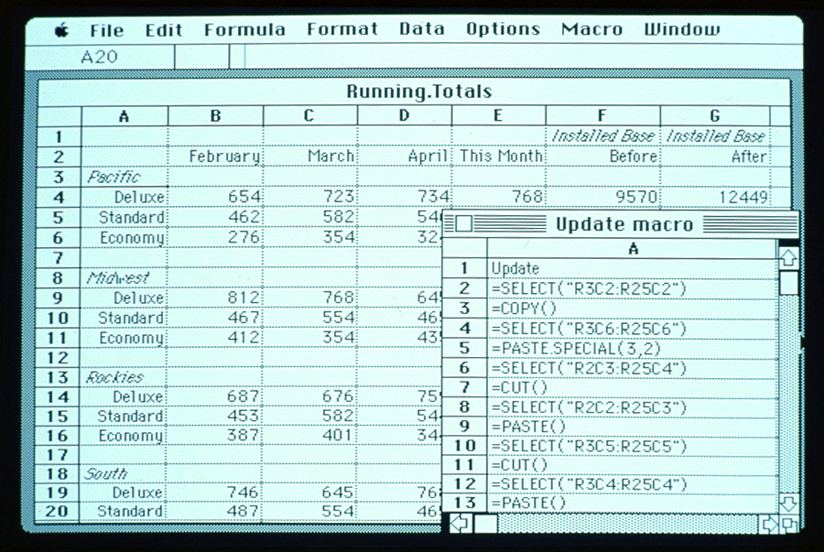
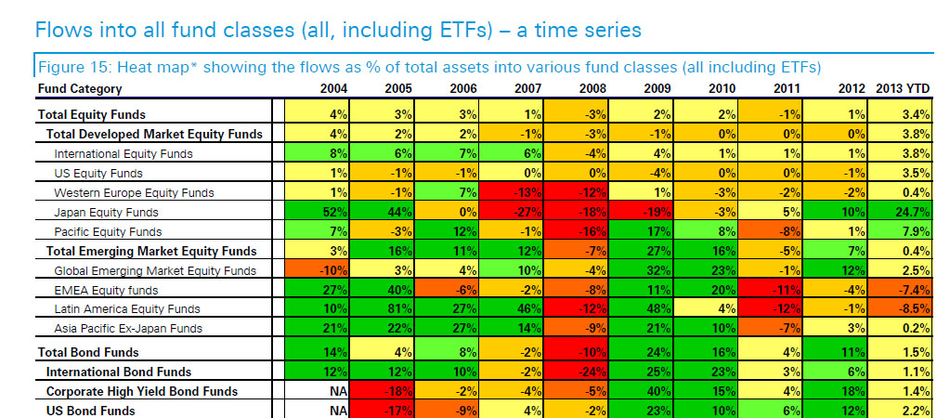
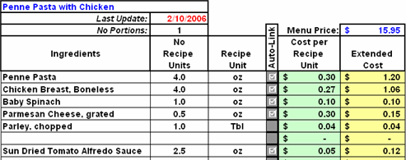
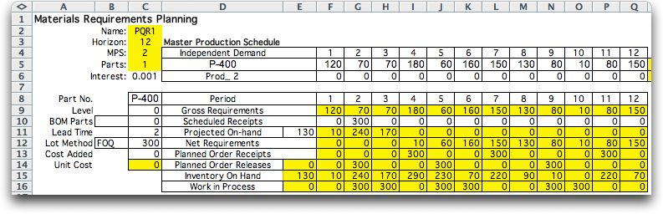

Slide 5
Agenda
Introduction
Connecting to Your Data
Data Interpreter
Preparing Data for Analysis
Split
Join
Union
Pivot
Editing the Metadata
Sharing Prepared Data

Slide 6
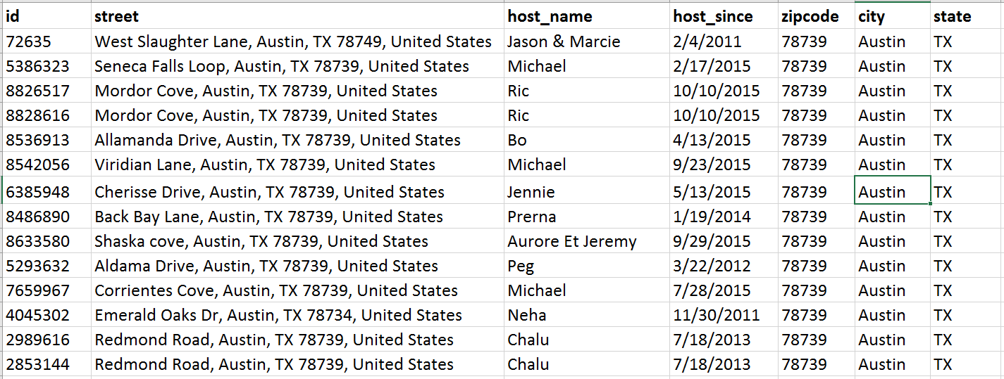
Your Data Set Should Look Like…

Slide 7
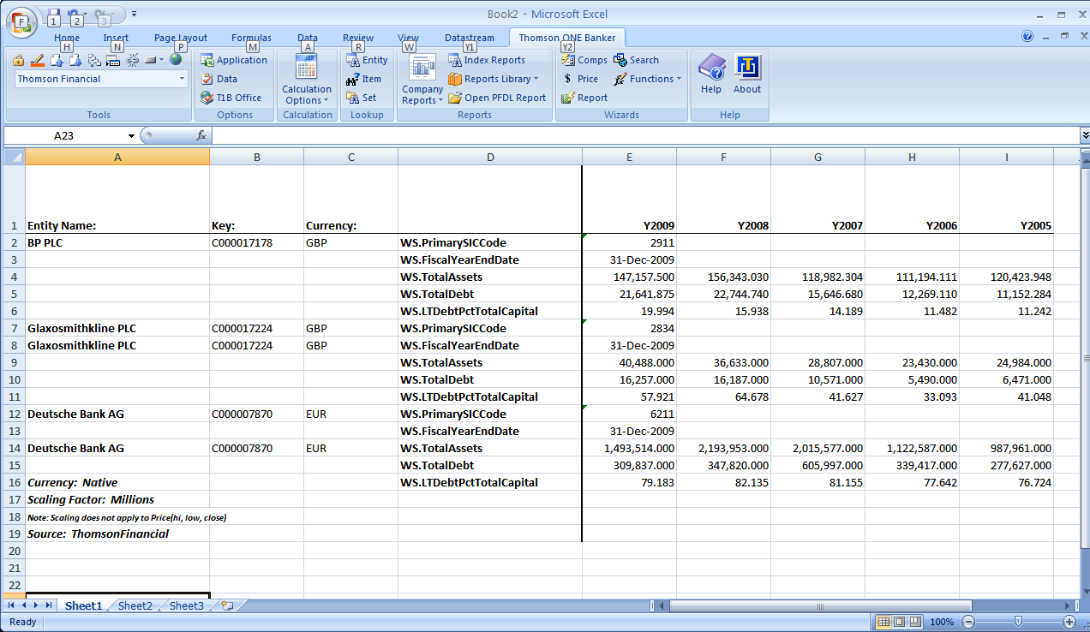
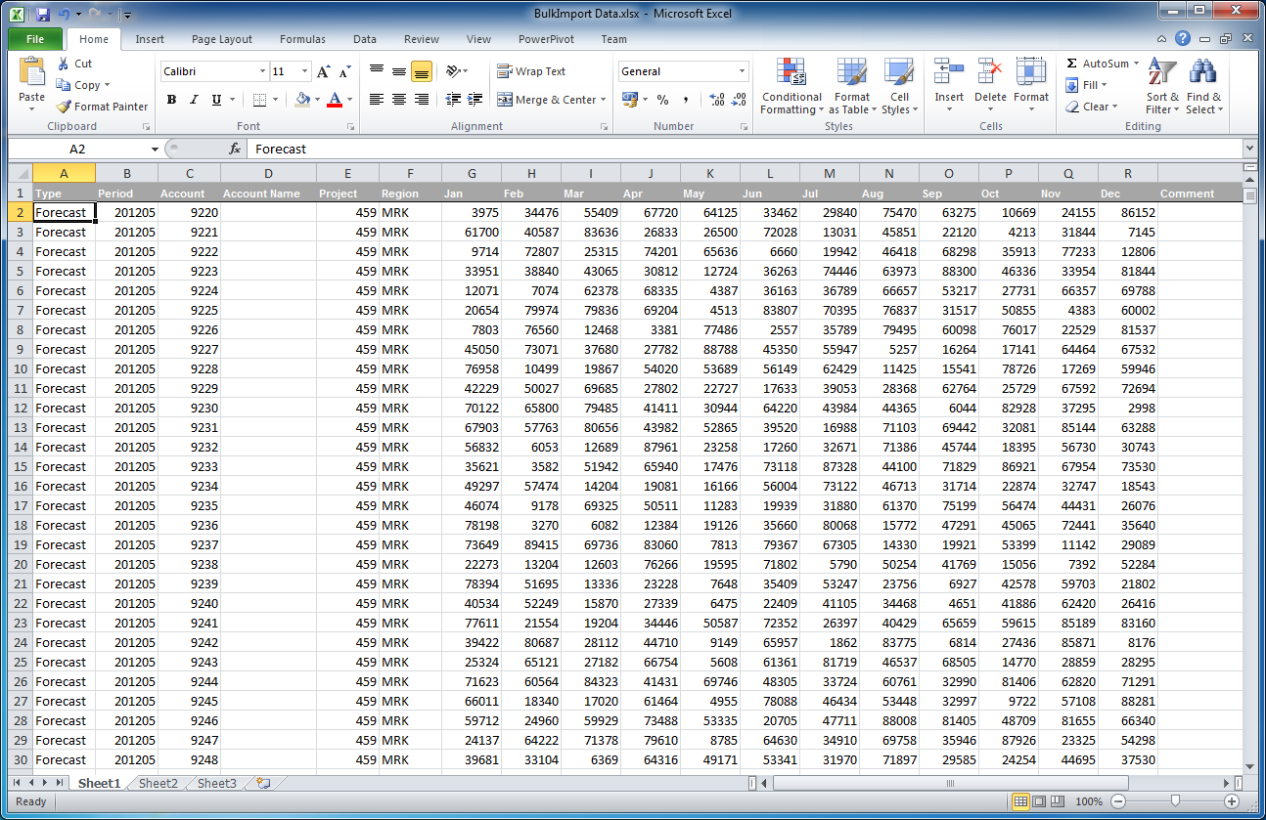
Common Issues with Excel Data

Slide 8
Your Data Set Should Look Like…

Slide 9





Where Does Your Data Live?
Flat File (Excel, CSV, …)
Database (SQL Server, Oracle, …)

Slide 10
Hands-On

Slide 11
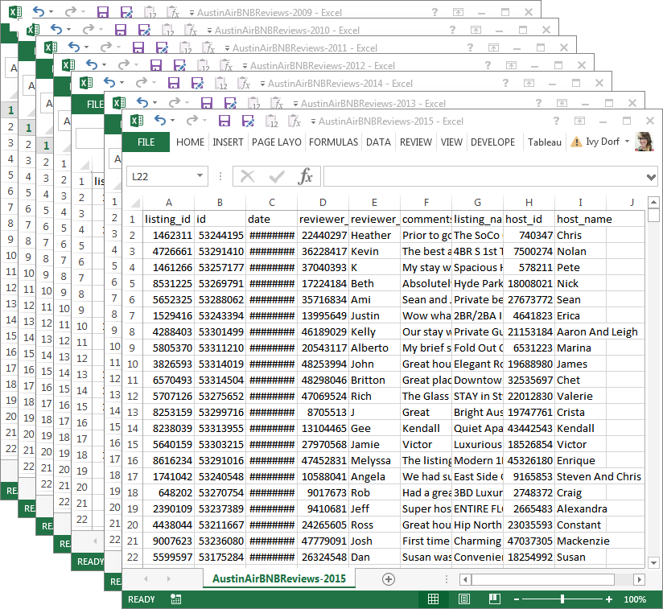
Union the Data

Slide 12
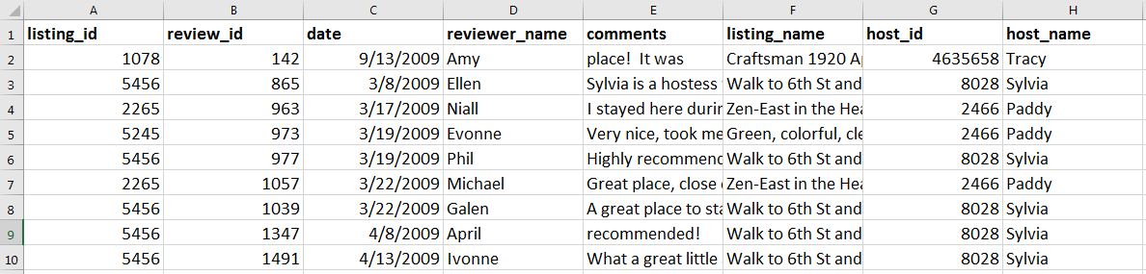
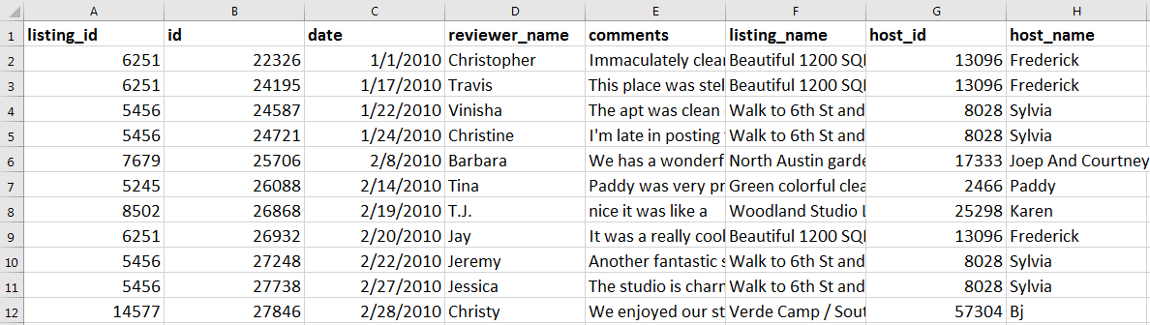
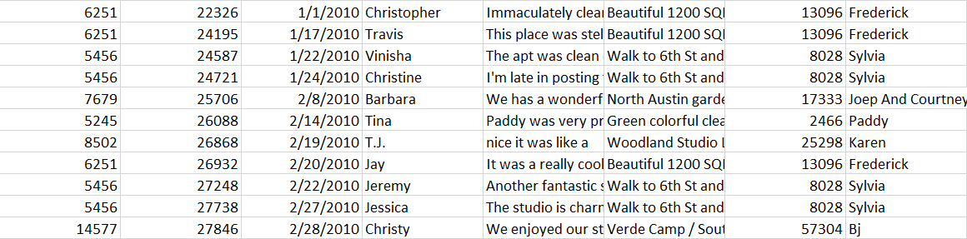
Union the Data
Table 1: Reviews 2009
Table 2: Reviews 2010
Sheet 2: July 23rd
Notes:
* Call out column B has two different names

Slide 13
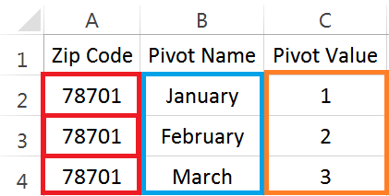
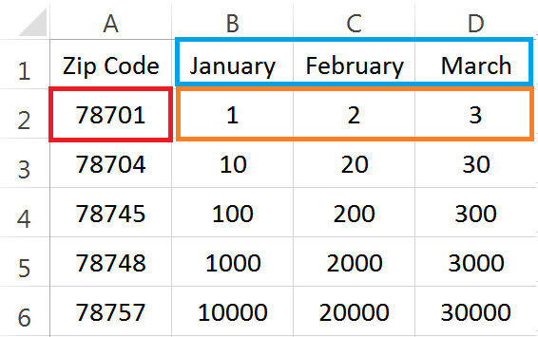
Pivot the Data

Slide 14
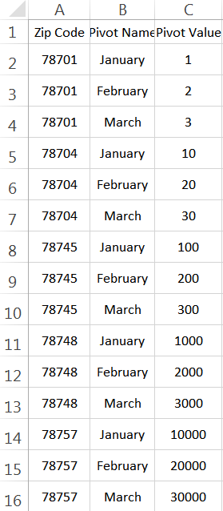
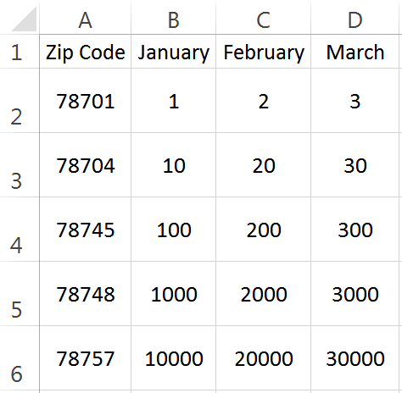
Pivot the Data

Slide 15


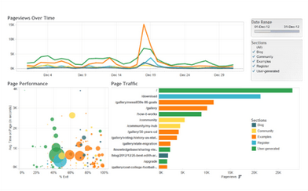



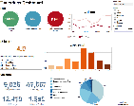








Sharing Data Using Data Server
Tableau Desktop User
Field Names
Hierarchies
Data Types
Groups
Sets
Calculations
Parameters
Aliases
Folders
Bins
Geographic Roles
Default Properties
Table Joins
Custom SQL
Workbooks | Data Sources
Tableau Server
Tableau Data Source (.tds/.tdsx)
Database

Slide 16
Session Summary
Limitations with Unprepared Data
How to Prepare Data in Tableau
Split
Join
Union
Pivot
Sharing Prepared Data
Tableau Data Source
Tableau Server

Slide 17
SESSION REPEATS
Tuesday, October 9 The Truth Is Out There (In Better Data Prep)
1045 – 115 PM | Room
Tuesday, October 9 The Truth Is Out There (In Better Data Prep)
1045 – 115 PM | Room
Tuesday, October 9 The Truth Is Out There (In Better Data Prep)
1045 – 115 PM | Room

Slide 18
RELATED SESSIONS
Tuesday, October 9 Beginning Your Geographic Analysis Journey
11:30am – 12:30pm | Location
Tuesday, October 9 Beginning Your Geographic Analysis Journey
11:30am – 12:30pm | Location
Tuesday, October 9 Beginning Your Geographic Analysis Journey
11:30am – 12:30pm | Location

Slide 19
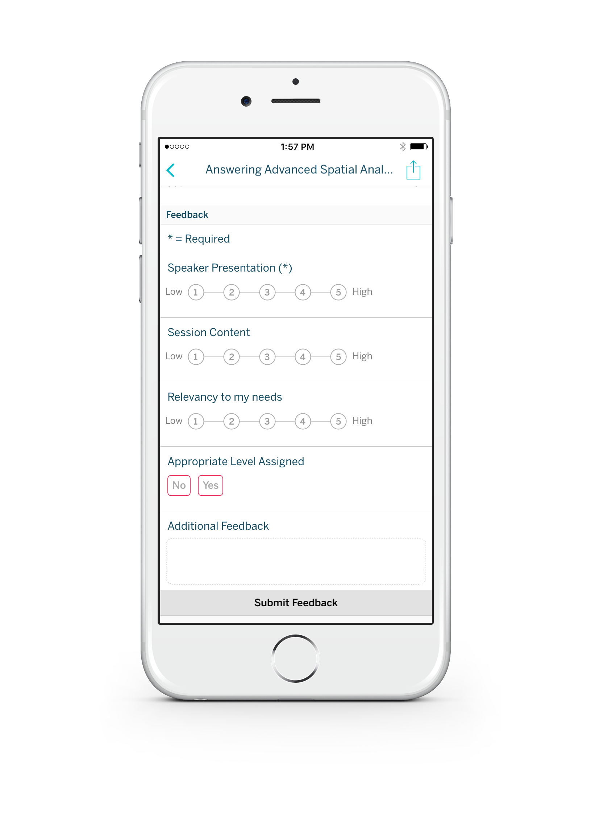
Please complete the session survey from the Session Details screen in your TC17 app

